Slide 1
Simulation of a Perceptron Based on Optical Devices Presentation
Hauptseminar Kommunikationssysteme
Yunbin Shen & Ming Ke

Slide 2
Contents
1 Introduction
2 The Simulated Perceptron
3 Program and Results
4 Conclusions

Slide 3
1 Introduction
What we did?
Create a framework for the analysis of all-optical ANN
Design a model of perceptron
Solve a simple problem
Realized in Python

Slide 4
1 Introduction
Overview
All-optical circuits realize the Deep Learning
No limit: electronic clock rates, ohmic losses
Higher speed and energy efficiency for learning tasks
Without additional energy input
Nonlinearity

Slide 5
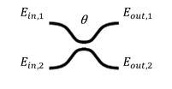
2 The Simulated Perceptron --Theoretical introduction of the simulated perceptron
Coupler
also called beam-splitter
a part of an optical amplifier circuit
mixes two input fields
parametrized by a matrix about a mixing angle θ

Slide 6
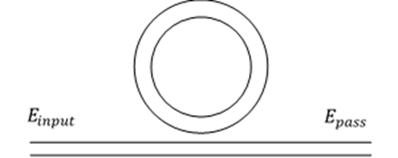

2 The Simulated Perceptron --Theoretical introduction of the simulated perceptron
Microring Resonator
Its input is one output of a coupler
Two main parameters:
To describe the feature of the resonator
circulating power buildup factor B
single pass phase shift $φ$

Slide 7
2 The Simulated Perceptron --Theoretical introduction of the simulated perceptron
Microring Resonator

Slide 8
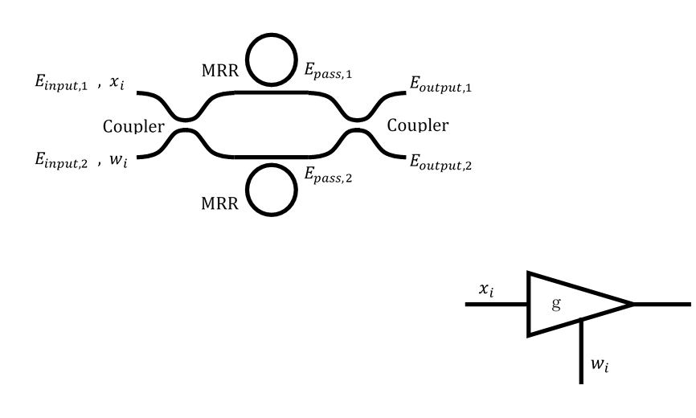
2 The Simulated Perceptron --Theoretical introduction of the simulated perceptron
Amplifier
tunable

Slide 9
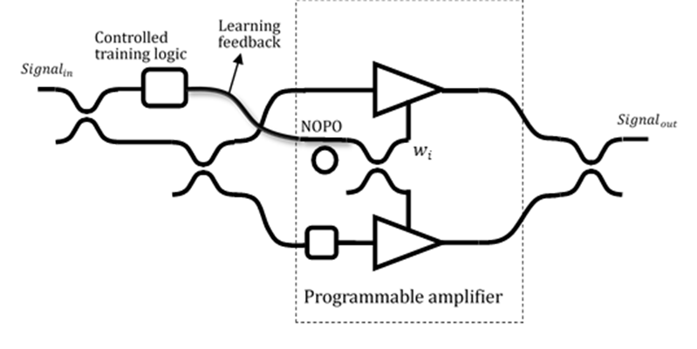
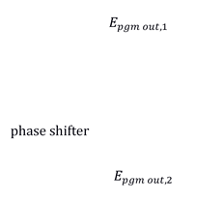
2 The Simulated Perceptron --Theoretical introduction of the simulated perceptron
Programmable Amplifier

Slide 10
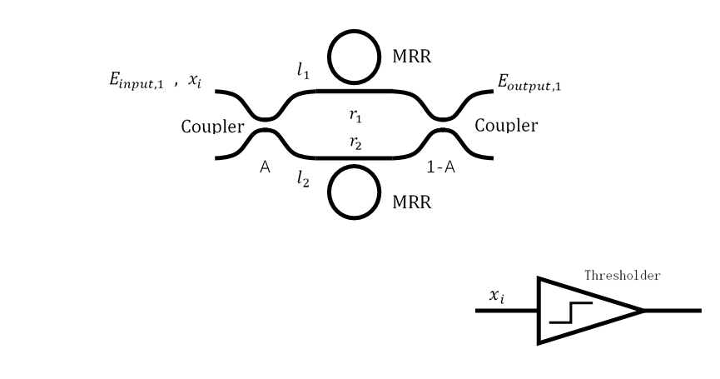
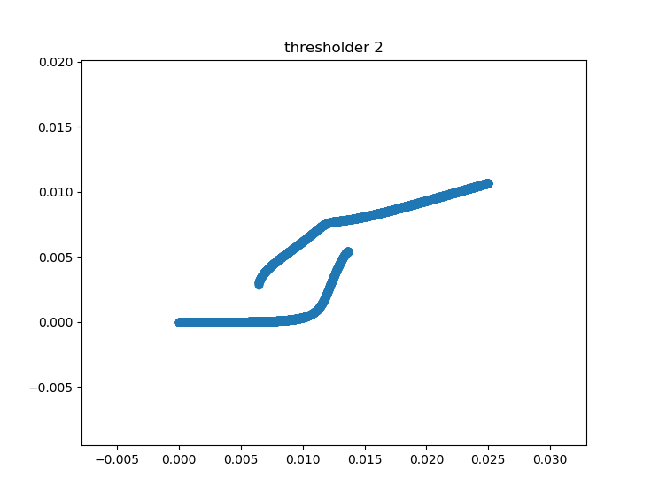
2 The Simulated Perceptron --Theoretical introduction of the simulated perceptron
Thresholder

Slide 11
2 The Simulated Perceptron --Theoretical introduction of the simulated perceptron
The structure of one all optical perceptron

Slide 12
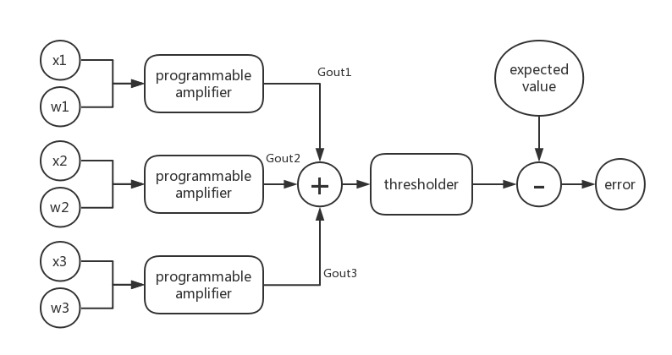
3 Program and Results Simulation of one all optical perceptron
The input data of the optical perceptron:
[ x1 x2 x3 expected (output) ]
Weights changed by each step: wi = wi + error * Gouti * η i=1,2,3

Slide 13
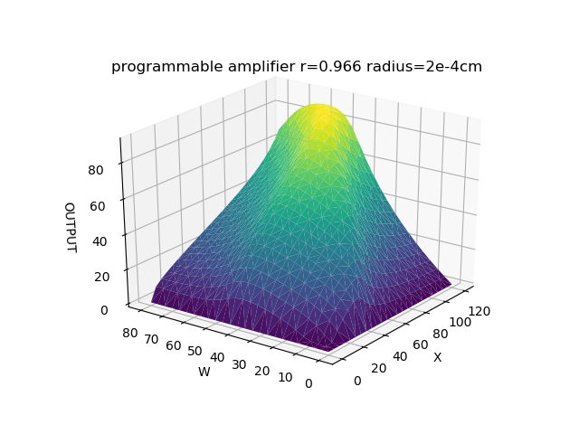
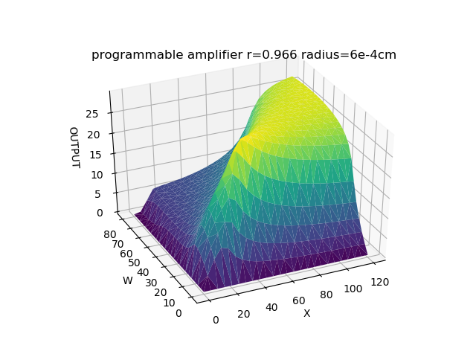
3 Program and Results Optical programmable amplifier
The character of the optical programmable amplifier depends very strongly on the self-coupling coefficient and the radius of the MRR.
r = 0.966, radius = 2e-4cm or 6e-4cm

Slide 14
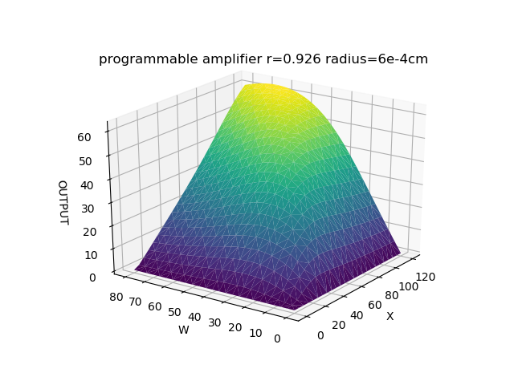
3 Program and Results Optical programmable amplifier
The character of the optical programmable amplifier depends very strongly on the self-coupling coefficient and the radius of the MRR.
r = 0.926 or 0.966, radius = 6e-4cm

Slide 15
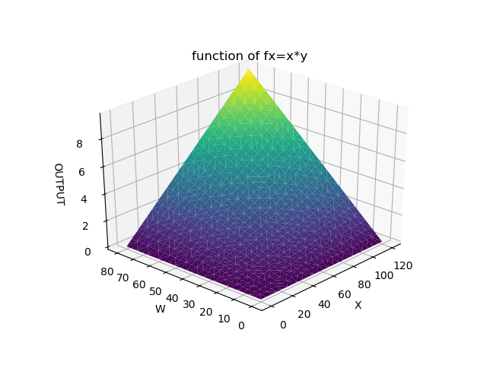
3 Program and Results Optical programmable amplifier
Compare to the ideal programmabler amplifier: f(x,y)=x*y
r = 0.926, radius = 6e-4cm

Slide 16
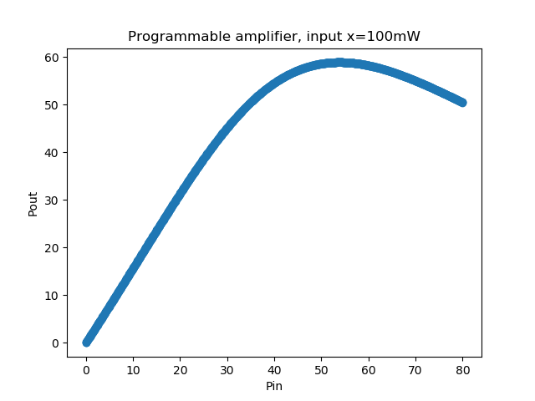
3 Program and Results Optical programmable amplifier
OR function, Training data X [ 0, 1 ],
the inputted power of X is defined as [0, 100mW]
Outcome is about 0-50mW

Slide 17
3 Program and Results Thresholder
Parameters: r1 = 0.970, r2 = 0.989, radius=4e-4cm, alpha=2.4
Bistability of the thresholder

Slide 18
3 Program and Results Training process
Training data of OR function:
0 or 0 = 0 0 or 1 = 1 1 or 0 = 1 1 or 1 = 1
Transfer into power
Input1(mW) | input2(mW) | enabled(mW) | output(mW)
0 | 0 | 100 | 0
0 | 100 | 100 | 15
100 | 0 | 100 | 15
100 | 100 | 100 | 15

Slide 19
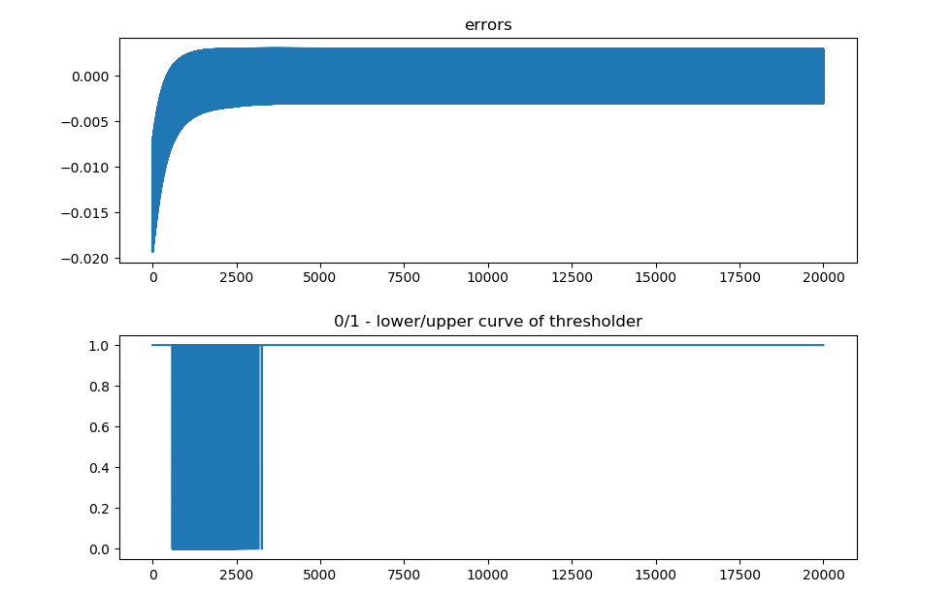
3 Program and Results Training process
Error during the training:

Slide 20
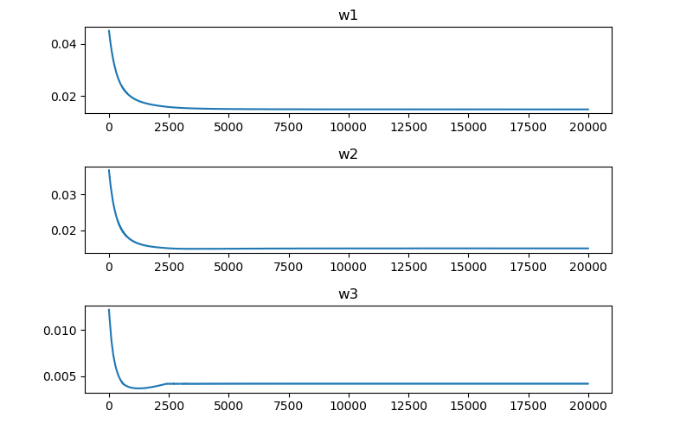
3 Program and Results Training process
Weights during the training:

Slide 21
3 Program and Results Training process
Output of the training:
w = [ 14.96mW 14.96mW 4.18mW ]
Input1 (mW) | Input2 (mW) | Enabled (mW) | Amplifier Output (mW) | Thresholder Output (mW) | Expected Value (mW)
0 | 0 | 100 | 6.44 | 2.98 | 0
0 | 100 | 100 | 29.94 | 12.02 | 15
100 | 0 | 100 | 29.93 | 12.01 | 15
100 | 100 | 100 | 53.43 | 17.97 | 15

Slide 22
4 Conclusions
Available
realize the OR function
the error can be smaller, if η is smaller and learning times are more
Meaningful
applied in analyzing and simulating future optical circuit
the ANN can be further built

Slide 23
THANK YOU!

